Slide 1
jQuery
Notes:
.

Slide 2
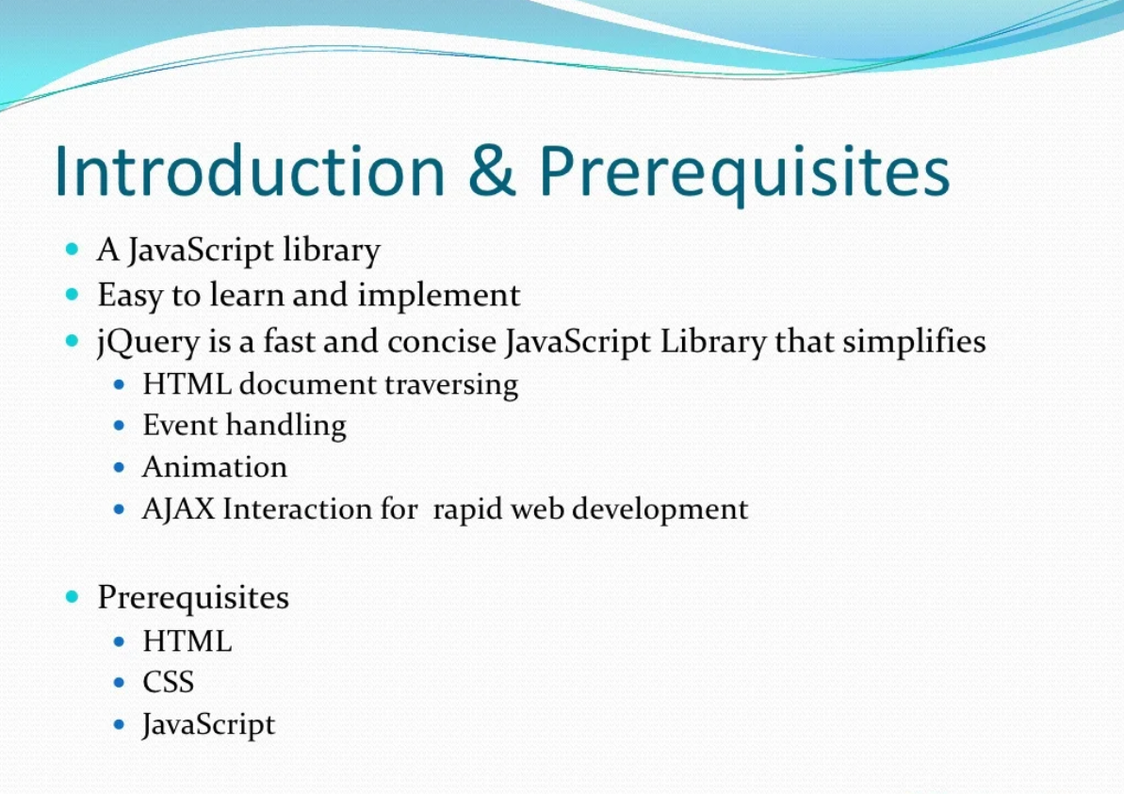

Slide 3
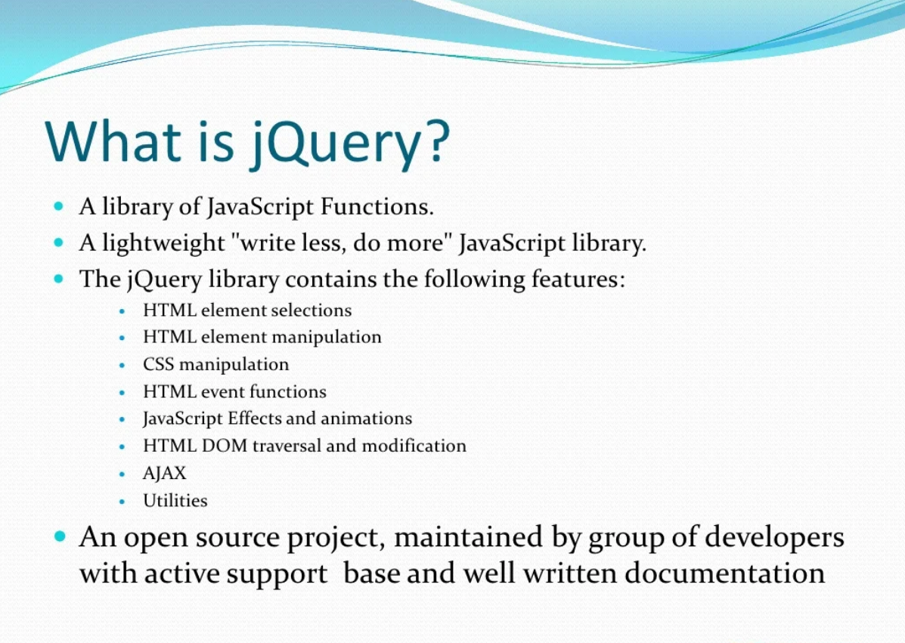

Slide 4
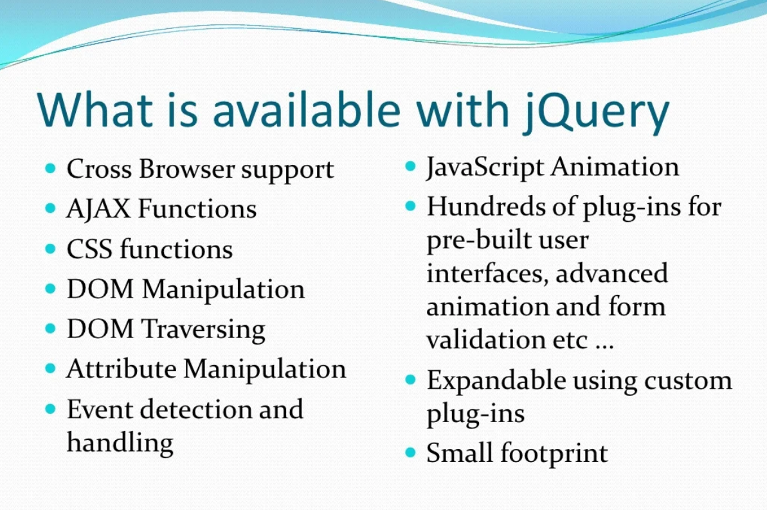

Slide 5
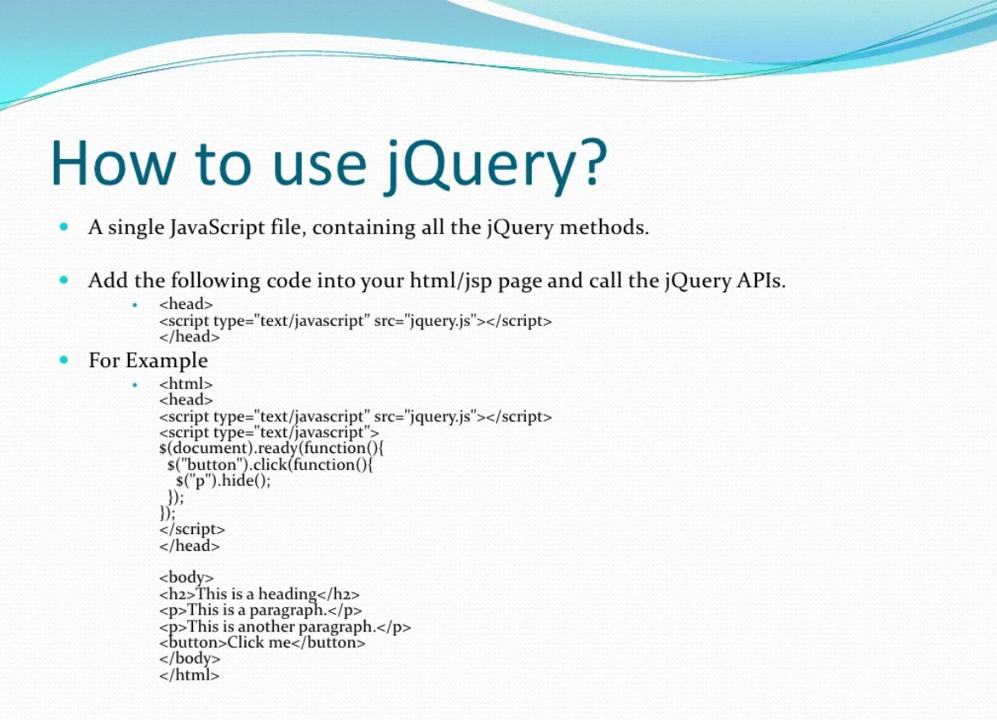

Slide 6
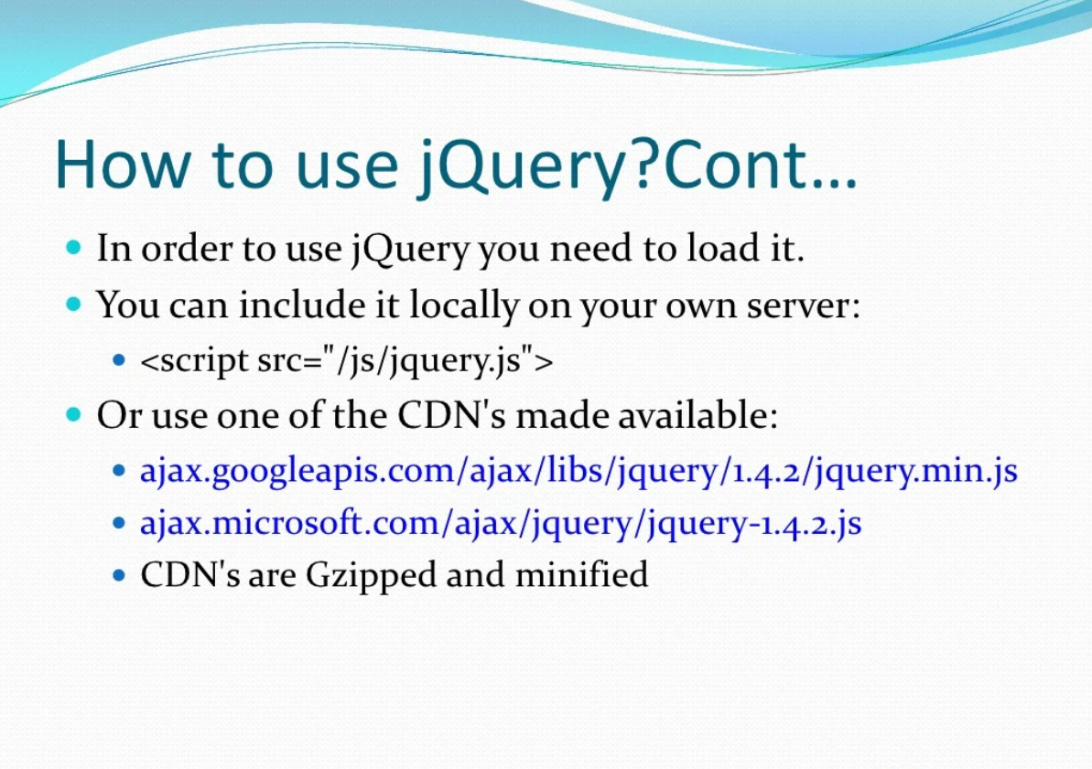

Slide 7
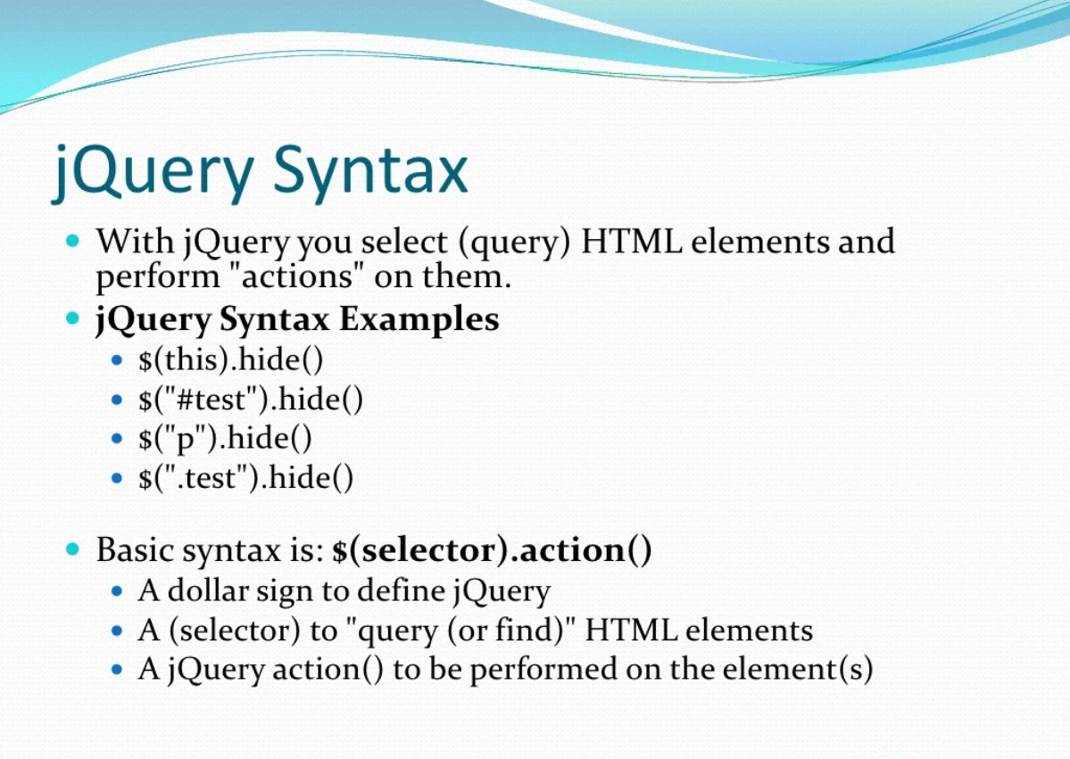

Slide 8
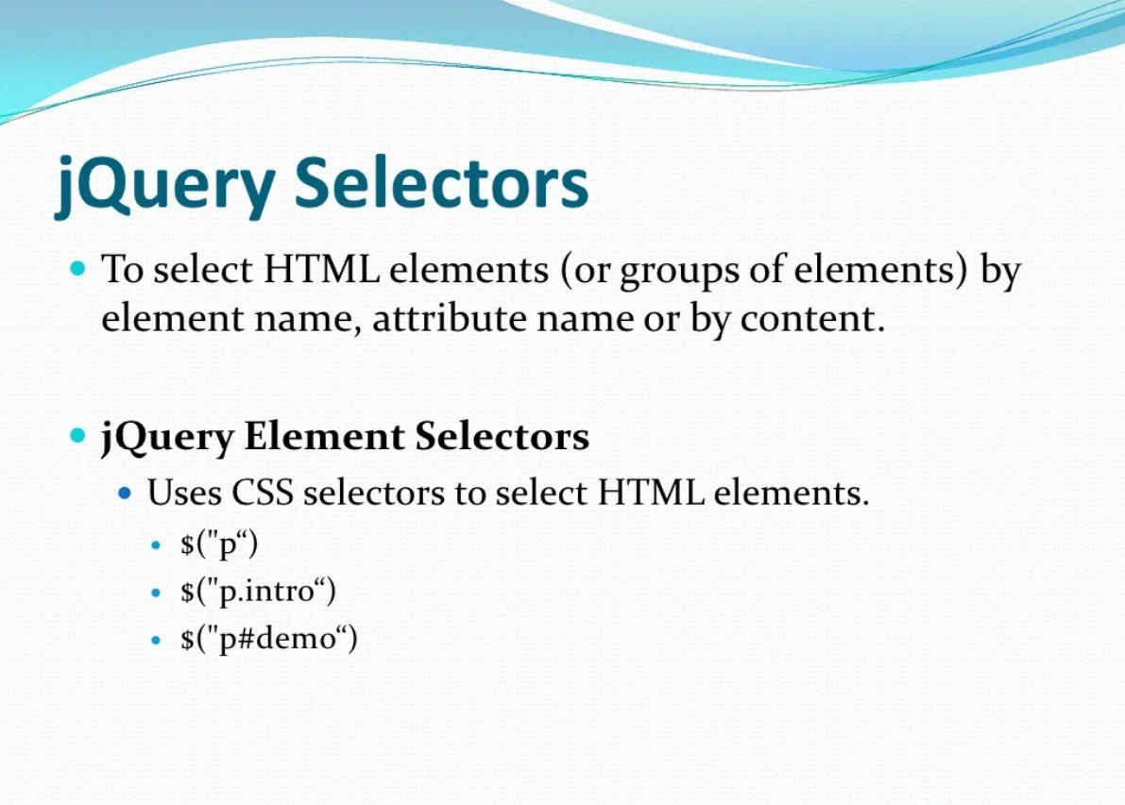

Slide 9
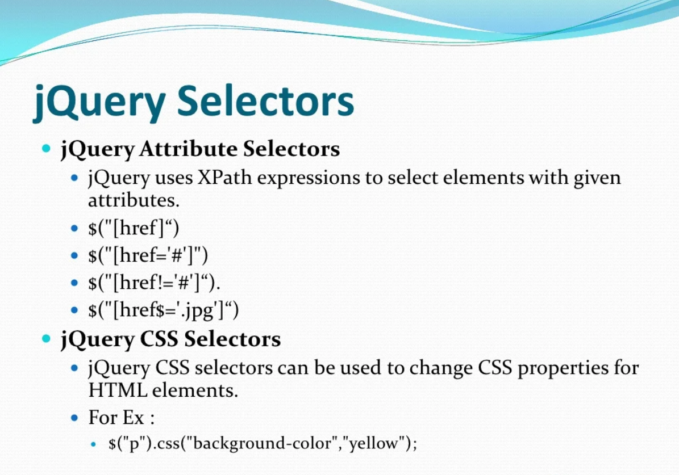

Slide 10
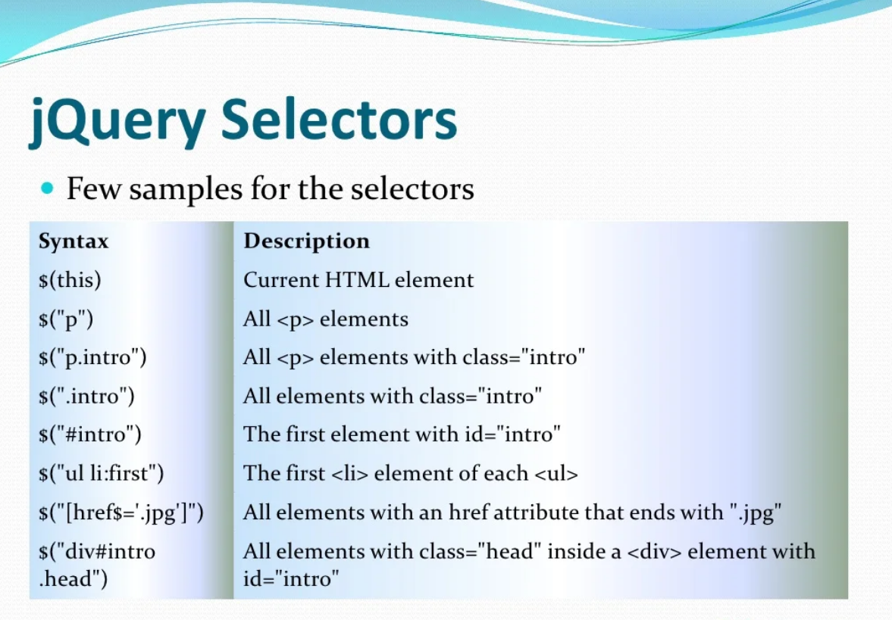

Slide 11
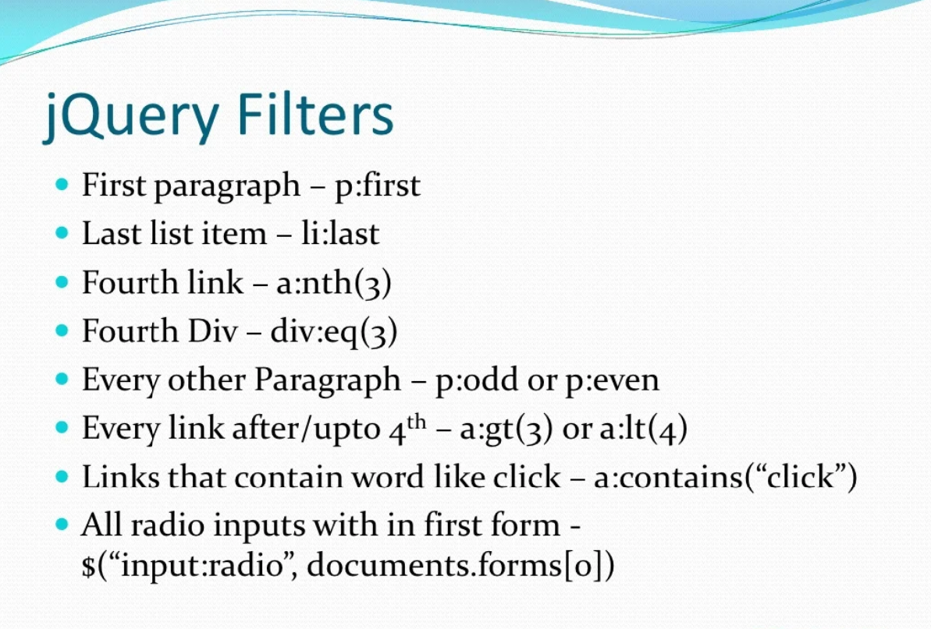

Slide 12
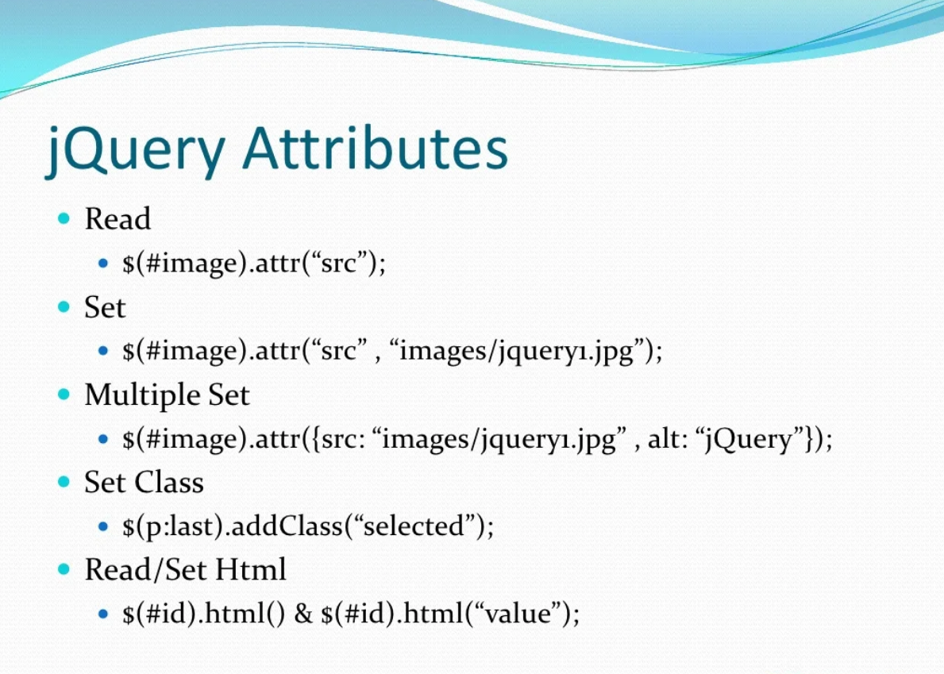

Slide 13
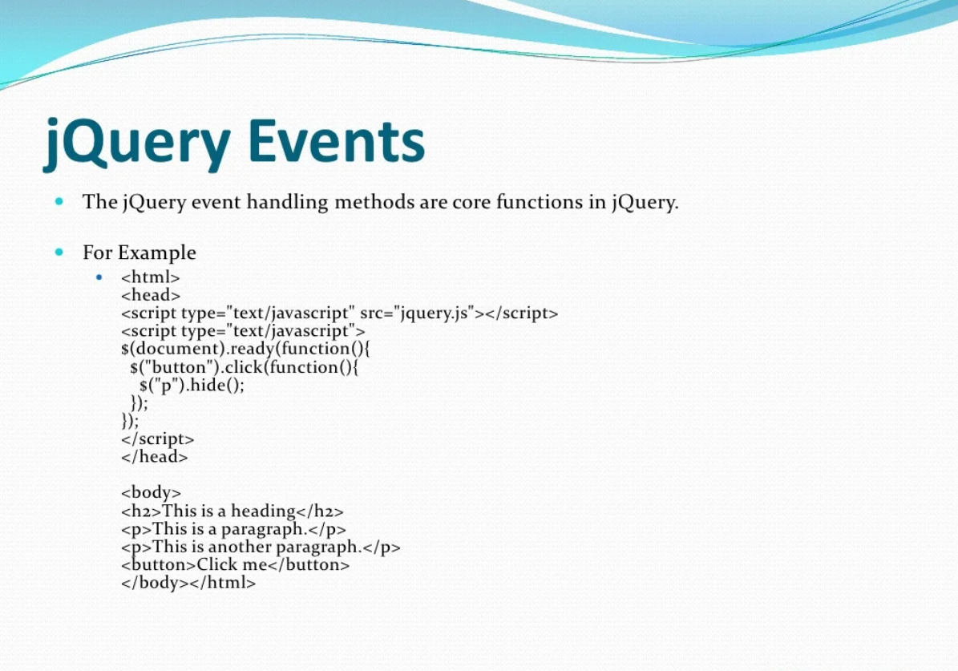

Slide 14
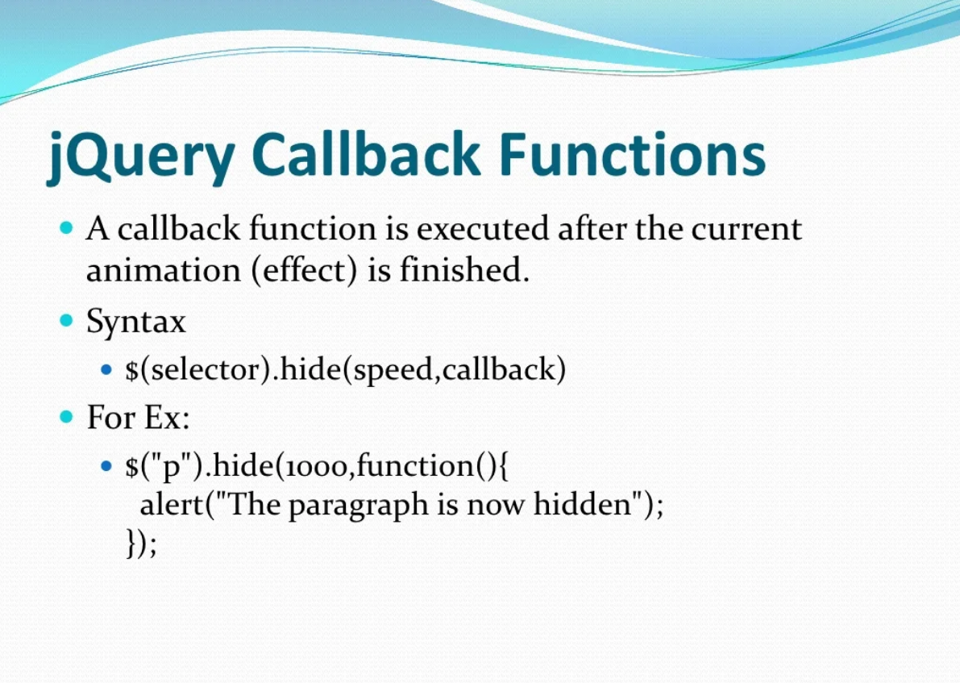

Slide 15
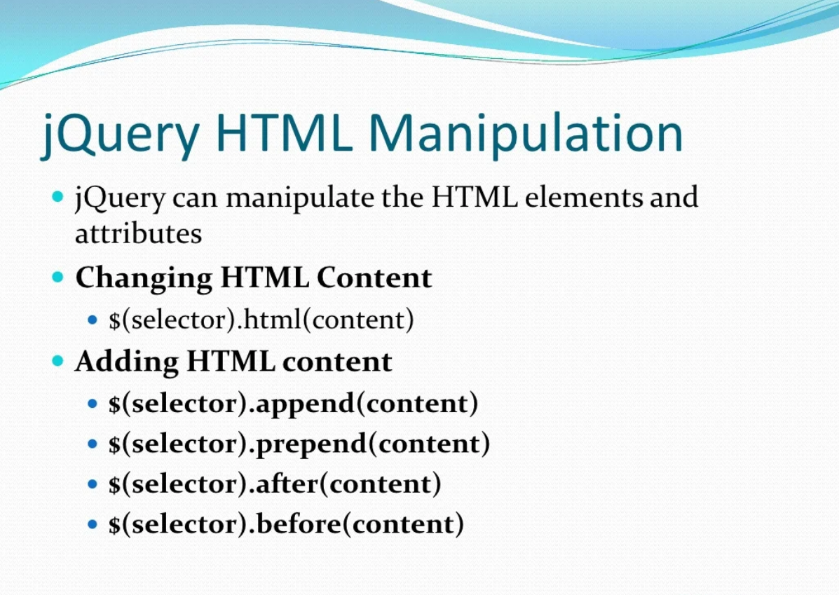

Slide 16
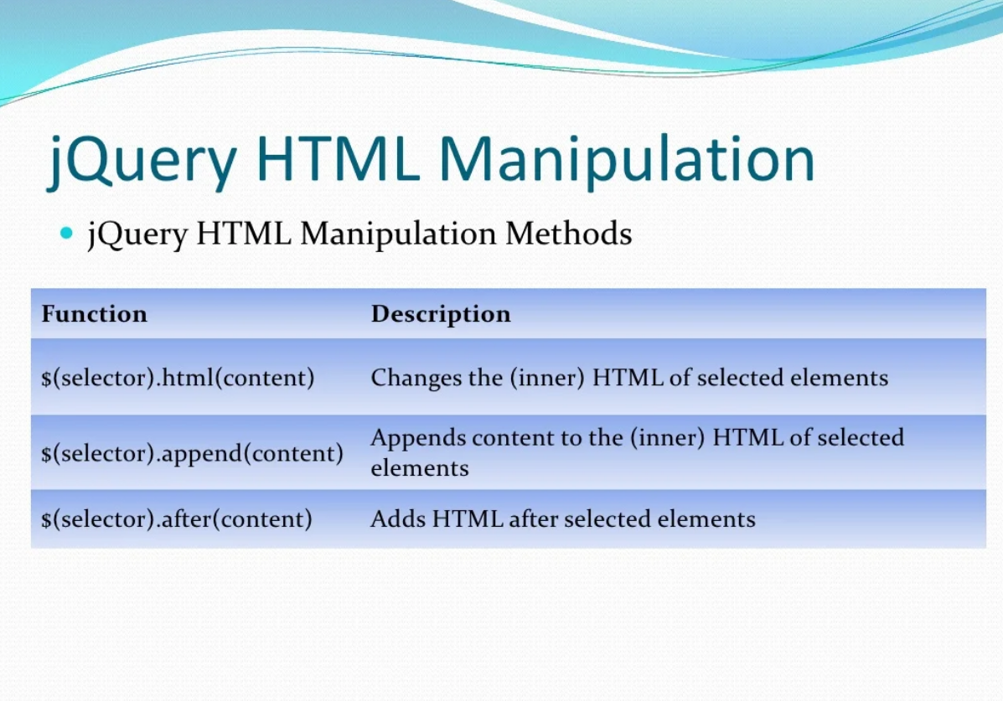

Slide 17
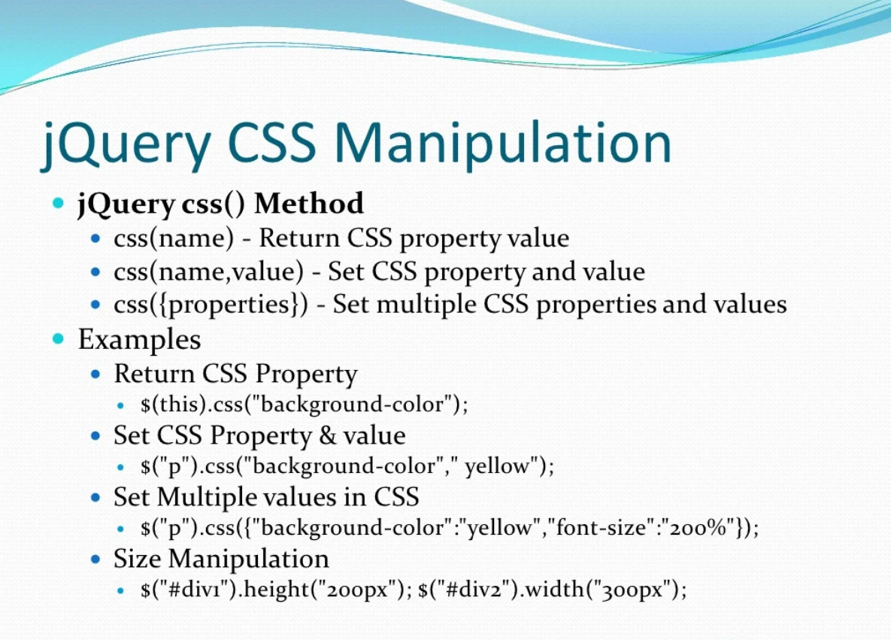

Slide 18
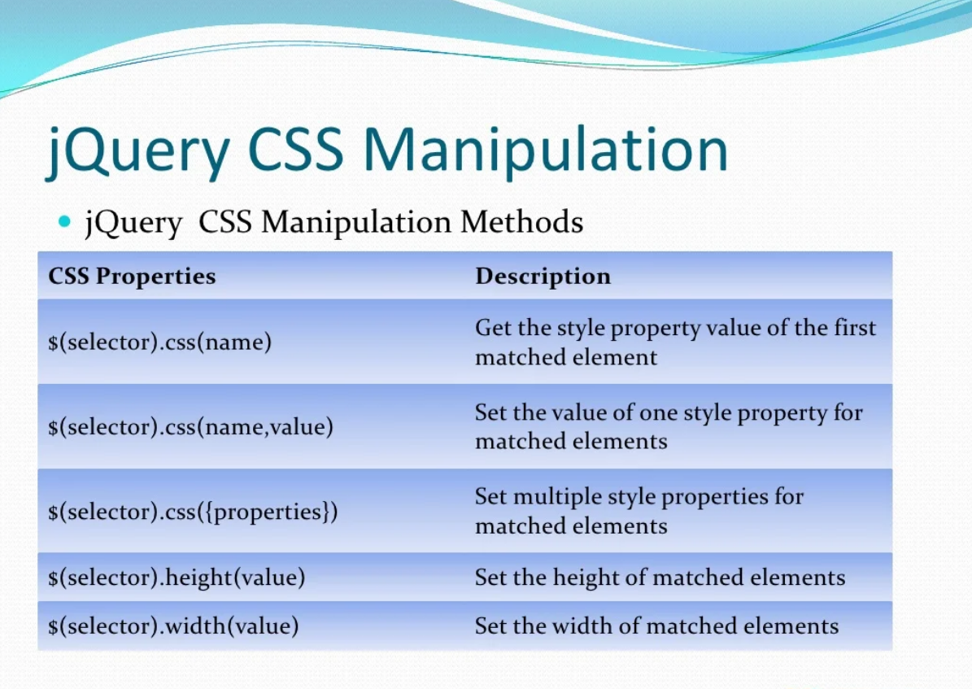

Slide 19
JQuery Effects

Slide 20
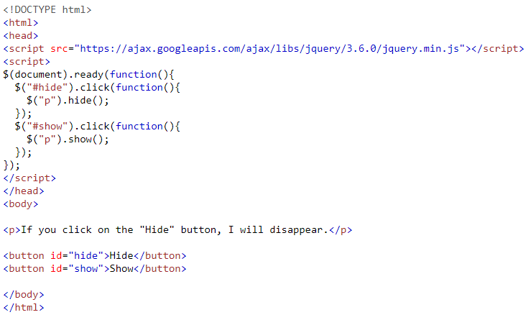
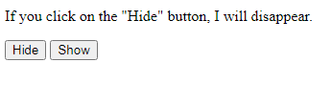
Hide/Show Example

Slide 21
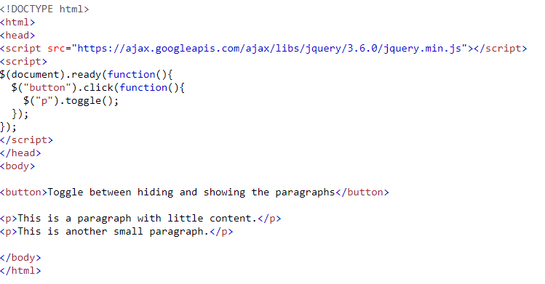
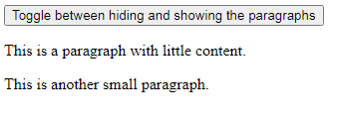
Toggle Example

Slide 22
jQuery Fading Effects
With jQuery you can fade elements in and out of visibility.
Click to fade in/out panel
Examples:
jQuery fadeIn() Demonstrates the jQuery fadeIn() method.
jQuery fadeOut() Demonstrates the jQuery fadeOut() method.
jQuery fadeToggle() Demonstrates the jQuery fadeToggle() method.
jQuery fadeTo() Demonstrates the jQuery fadeTo() method.

Slide 23
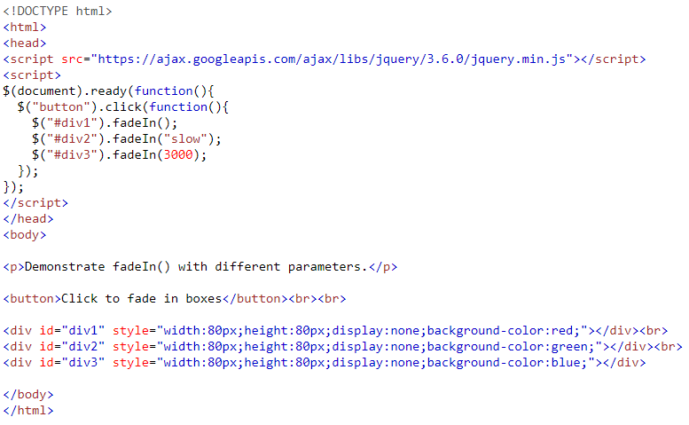
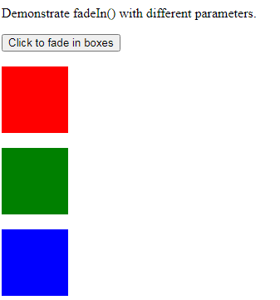
Fading Example

Slide 24
jQuery Effects - Sliding
Examples
jQuery slideDown() Demonstrates the jQuery slideDown() method.
jQuery slideUp() Demonstrates the jQuery slideUp() method.
jQuery slideToggle() Demonstrates the jQuery slideToggle() method.

Slide 25
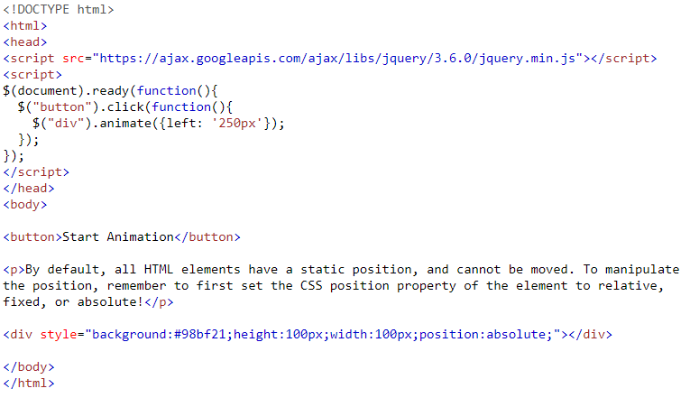
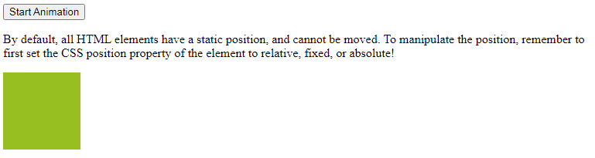
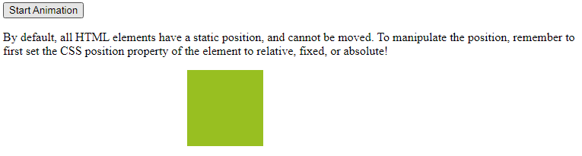
Animate Example

Slide 26
TASKS
Make homepage slider with effects have following Elements:
One Image
Three Buttons (Fade In, Fade out, Animate the Width)
Also Change BgColor by clicking on the above buttons (R,G,B)

Slide 27
Ajax
AJAX = Asynchronous JavaScript and XML.
In short; AJAX is about loading data in the background and display it on the webpage, without reloading the whole page.
Examples of applications using AJAX: Gmail, Google Maps, Youtube, and Facebook tabs.

Slide 28
jQuery load() Method
The jQuery load() method is a simple, but powerful AJAX method.
The load() method loads data from a server and puts the returned data into the selected element.
Syntax:
$(selector).load(URL,data,callback);
The required URL parameter specifies the URL you wish to load.
The optional data parameter specifies a set of querystring key/value pairs to send along with the request.
The optional callback parameter is the name of a function to be executed after the load() method is completed.
The callback function can have different parameters:
responseTxt - contains the resulting content if the call succeeds
statusTxt - contains the status of the call
xhr - contains the XMLHttpRequest object

Slide 29
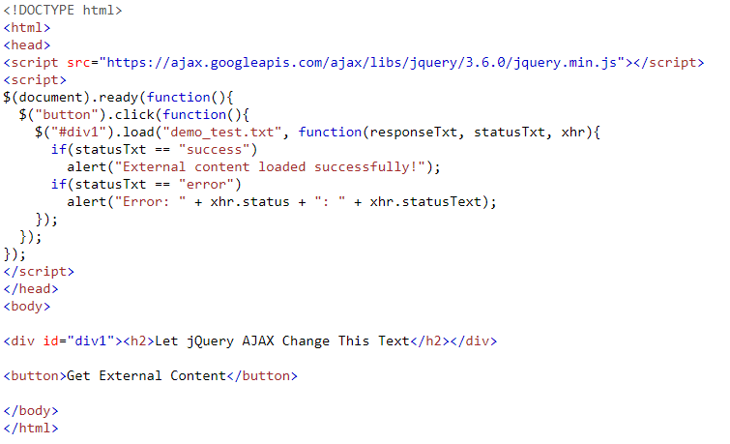
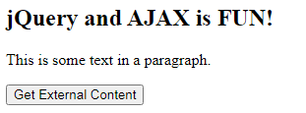
Ajax example

Slide 30
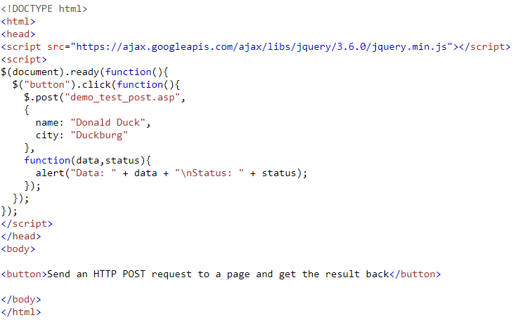
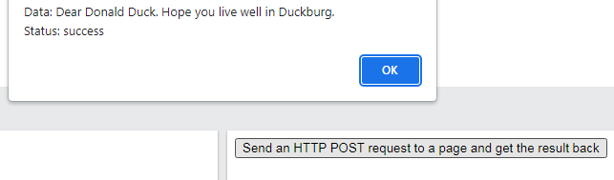
Post/get ajax requests

Slide 31
THANKS

